Slide 1
Reinforcement Learning for Inventory Optimization
Larry Snyder
Professor, Industrial and Systems Engineering
Director, I-DISC
RL for Operations Summer Bootcamp
Northwestern University, Aug. 18, 2022

Slide 2
The Multi-Period Newsvendor Problem as an MDP
Part 2

Slide 3
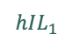
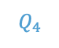
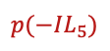
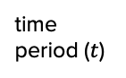
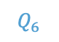
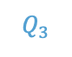
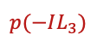
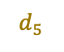
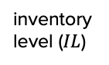
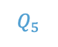
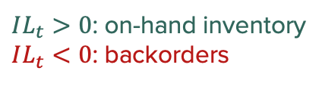
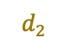
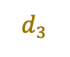
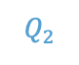
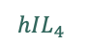
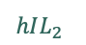
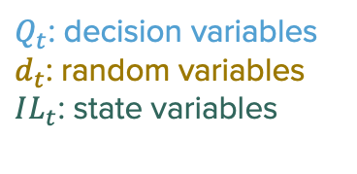
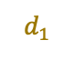
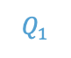

The MPNV: Inventory dynamics
$Q_{t}$: decision variables
$d_{t}$: random variables
$IL_{t}$: state variables
inventory level ($IL$)
$IL_{t}>0$: on-hand inventory
$IL_{t}<0$: backorders
$$d_{2}$$
$$Q_{3}$$
$$Q_{2}$$
$$Q_{5}$$
$$Q_{1}$$
$$d_{3}$$
$$d_{1}$$
$$d_{5}$$
$$hIL_{2}$$
$$d_{4}$$
$$Q_{6}$$
$$Q_{4}$$
$$hIL_{1}$$
$$hIL_{4}$$
time period ($t$)
$$p(−IL_{3})$$
$$p(−IL_{5})$$

Slide 4
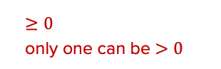
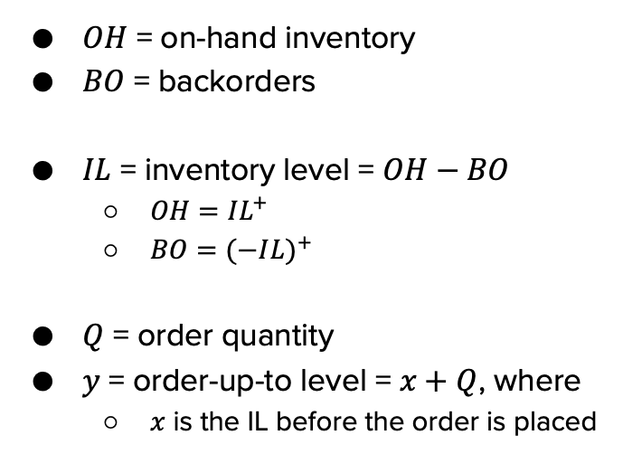
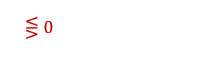
Terminology and notation
$OH$ = on-hand inventory
$BO$ = backorders
$IL$ = inventory level = $OH−BO$
$OH=IL^{+}$
$BO=(−I{L)}^{+}$
$Q$ = order quantity
$y$ = order-up-to level = $x+Q$, where
$x$ is the IL before the order is placed
$$≥0$$
only one can be $>0$
$$⋚0$$

Slide 5
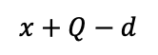
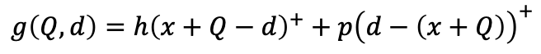
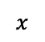
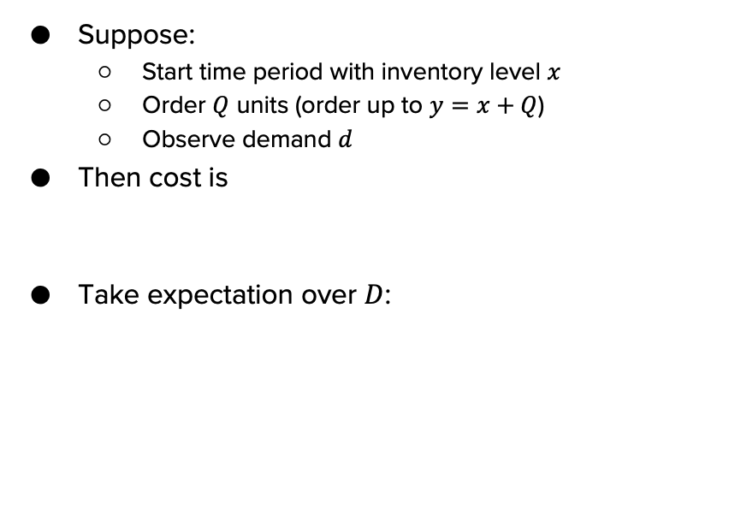
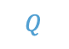
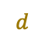
Expected cost function
Suppose:
Start time period with inventory level $x$
Order $Q$ units (order up to $y=x+Q$)
Observe demand $d$
Then cost is
Take expectation over $D$:
$$Q$$
$$d$$
$$g\left(Q,d\right)=h{\left(x+Q−d\right)}^{+}+p{\left(d−\left(x+Q\right)\right)}^{+}$$
$$x$$
$$x+Q−d$$
$$g\left(Q\right)=𝔼\left[h{\left(x+Q−D\right)}^{+}+p{\left(D−\left(x+Q\right)\right)}^{+}\right]$$

Slide 6
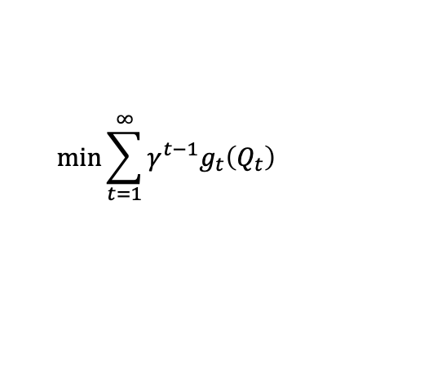
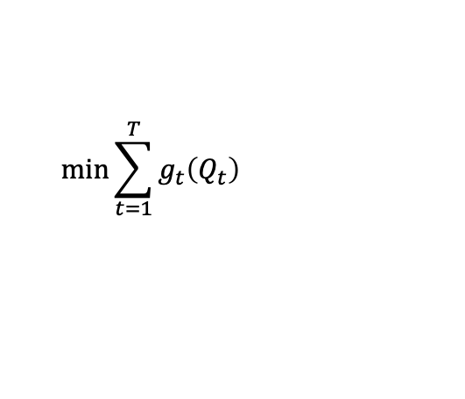
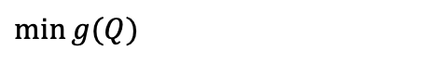
Three flavors of MPNV
$$\min{\sum_{t=1}^{T}{g_{t}\left(Q_{t}\right)}}$$
Finite horizon:
Infinite horizon, discounted cost:
Infinite horizon, average cost:
$$\min{\sum_{t=1}^{∞}{γ^{t−1}g_{t}\left(Q_{t}\right)}}$$
$$\min{g(Q)}$$

Slide 7
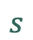
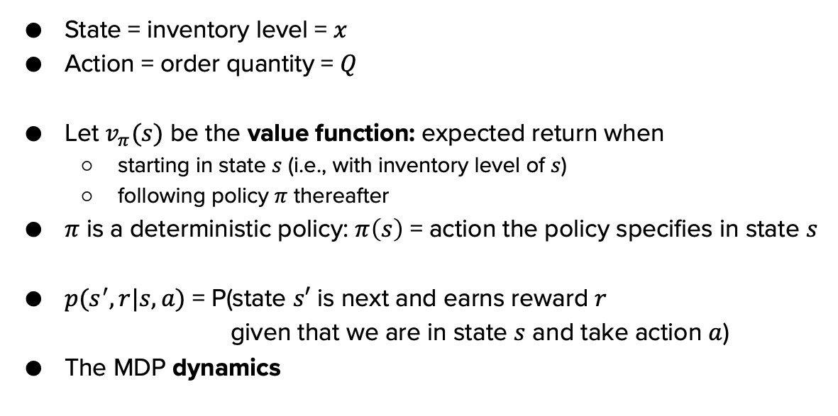
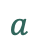
Formulation as MDP
State = inventory level = $x$
Action = order quantity = $Q$
Let $v_{π}(s)$ be the value function: expected return when
starting in state $s$ (i.e., with inventory level of $s$)
following policy $π$ thereafter
$π$ is a deterministic policy: $π\left(s\right)$ = action the policy specifies in state $s$
$p(s^{′},r|s,a)$ = P(state $s′$ is next and earns reward $r$ given that we are in state $s$ and take action $a$)
The MDP dynamics
$$s$$
$$a$$

Slide 8
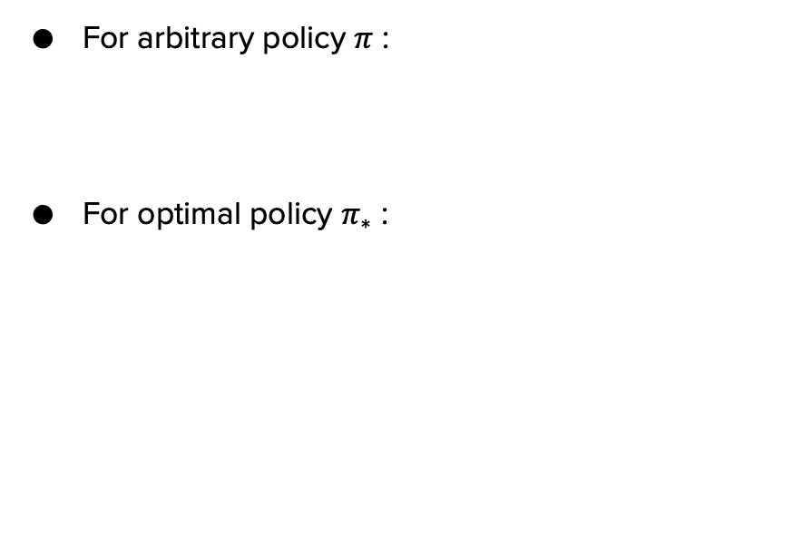
Bellman equations
For arbitrary policy $π$ :
For optimal policy $π_{∗}$ :
$$v_{π}\left(s\right)=𝔼\left[−{\left(h{\left(s+a−d\right)}^{+}+p(d−(s+a)\right)}^{+}+γv_{π}(s+a−D)\right]$$
$$v_{∗}\left(s\right)=\max_{a≥0}{𝔼\left[−{\left(h{\left(s+a−d\right)}^{+}+p(d−(s+a)\right)}^{+}+γv_{π}(s+a−D)\right]}$$

Slide 9
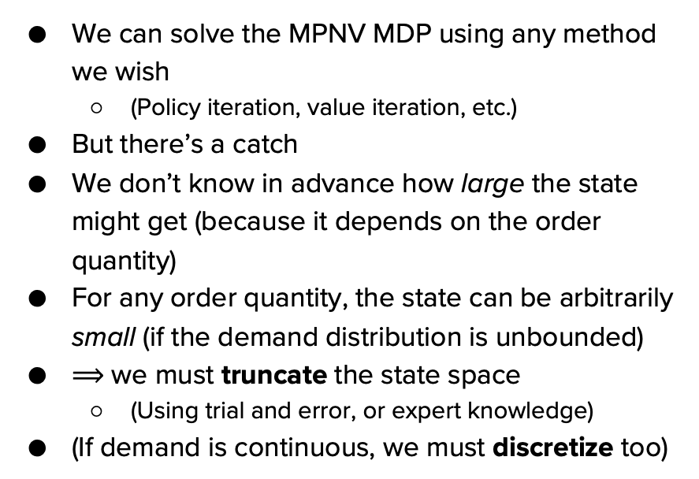
Solving the MDP
We can solve the MPNV MDP using any method we wish
(Policy iteration, value iteration, etc.)
But there’s a catch
We don’t know in advance how large the state might get (because it depends on the order quantity)
For any order quantity, the state can be arbitrarily small (if the demand distribution is unbounded)
$⟹$ we must truncate the state space
(Using trial and error, or expert knowledge)
(If demand is continuous, we must discretize too)
$$Q$$
$$d$$
$$x$$
$$x+Q−d$$

Slide 10
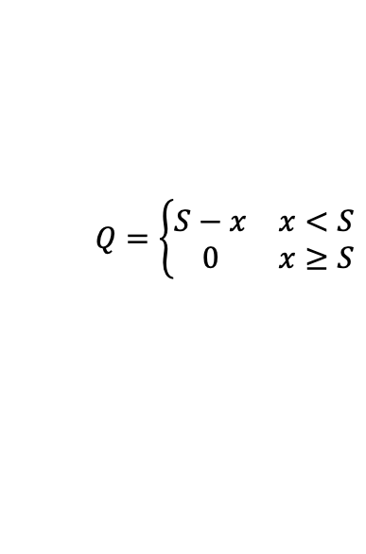
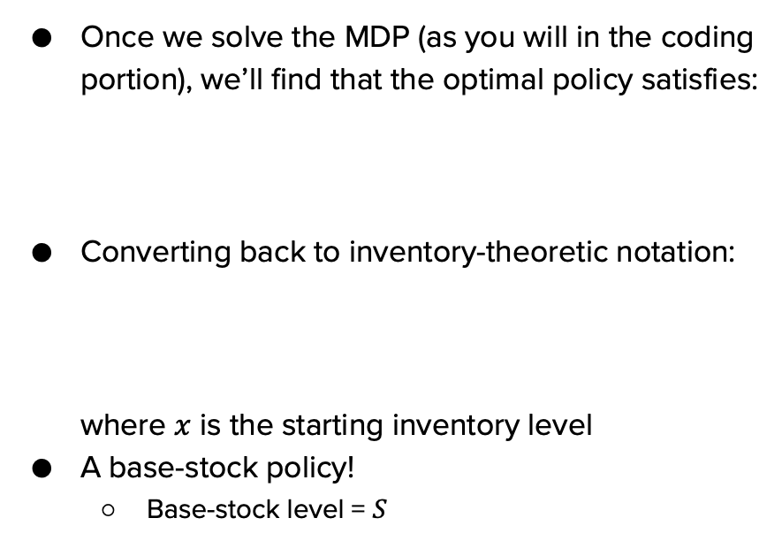
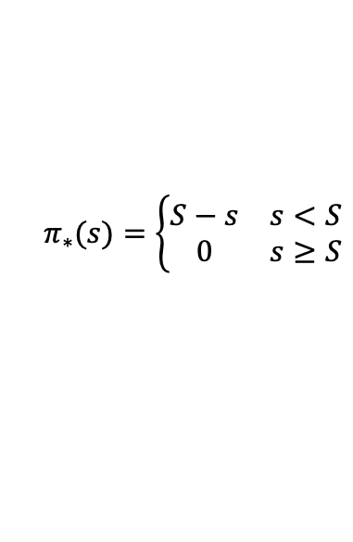
Optimal policy
Once we solve the MDP (as you will in the coding portion), we’ll find that the optimal policy satisfies:
Converting back to inventory-theoretic notation: where $x$ is the starting inventory level
A base-stock policy!
Base-stock level = $S$
$$π_{∗}(s)=\left\{\begin{matrix}S−s & s<S \\ 0 & s≥S\end{matrix}\right.$$
$$Q=\left\{\begin{matrix}S−x & x<S \\ 0 & x≥S\end{matrix}\right.$$

Slide 11
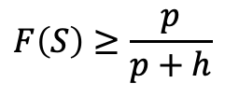
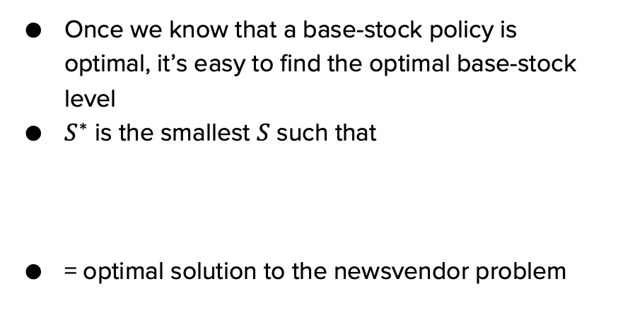
Optimizing the base-stock level
Once we know that a base-stock policy is optimal, it’s easy to find the optimal base-stock level
$S^{∗}$ is the smallest $S$ such that
= optimal solution to the newsvendor problem
$$F\left(S\right)≥\frac{p}{p+h}$$

Slide 12
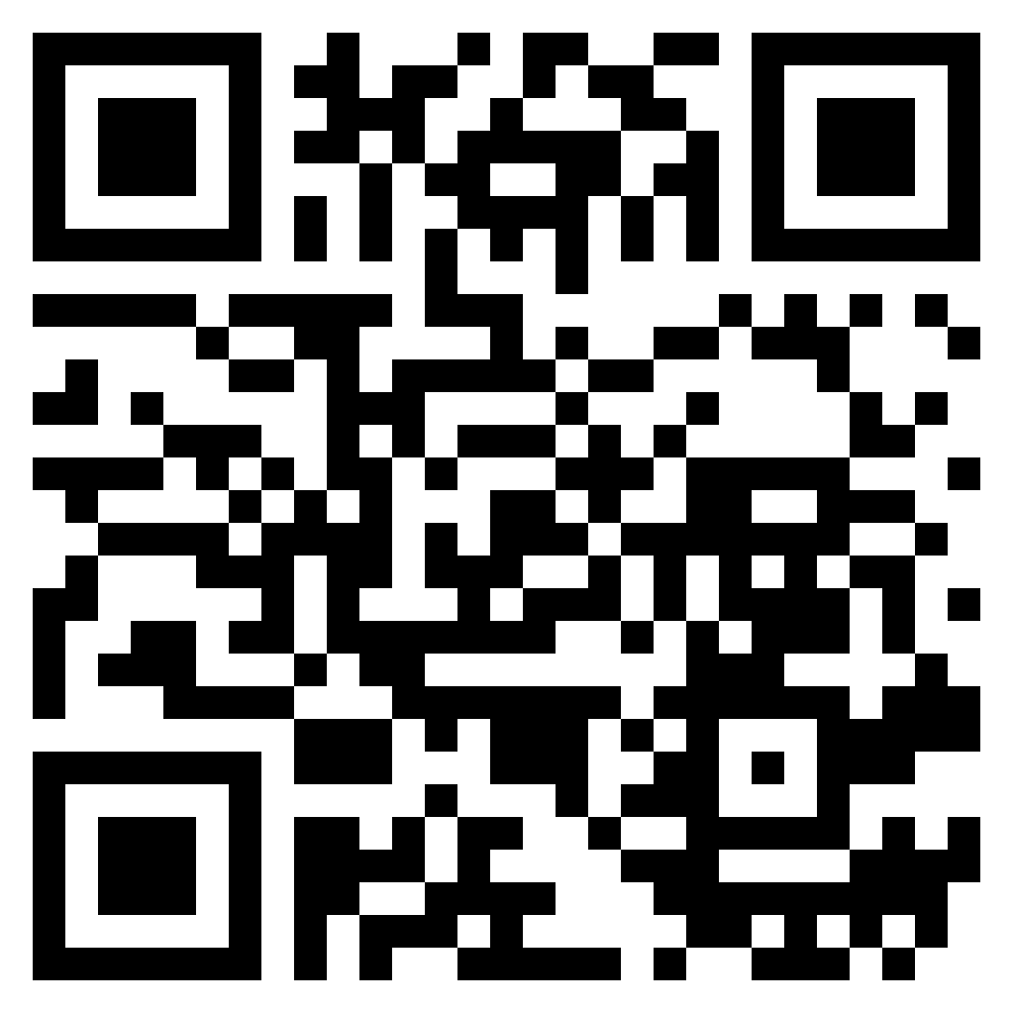
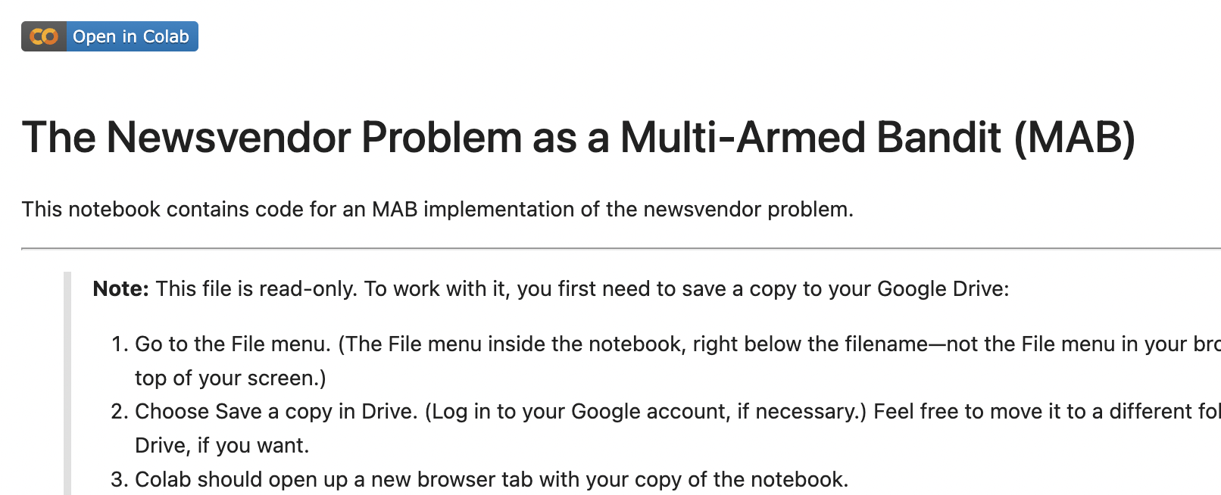
Coding time!
Go to github.com/LarrySnyder/RLforInventory
Click notebooks
Click 2: MPNV as MDP.ipynb
Click the “Open in Colab” button:
Follow the directions in the notebook to make your own copy
Work through the notebook at your own pace

Slide 13
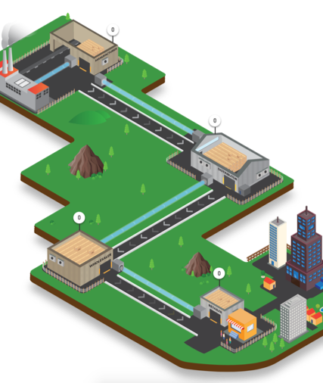

Questions?
larry.snyder@lehigh.edu
https://coral.ise.lehigh.edu/larry/
Supported in part by NSF grants NSF:CCF:1618717, NSF:CMMI:1663256, NSF:CCF:1740796, and XSEDE:DDM180004.

